Slide 1
Banking Management System A Project with C++
By : Mohammad Badiuzzaman Shuvo ( 1607043 )

Slide 2
Introduction
This project was built on the basis of banking management system. It can handle New accounts by creating new account files. It can update the balance or other information's. It can delete accounts with associated files. It can search an account with given search item (string) . View an existing account. The data for each accounts is stored in a new file. But some of the basic information (like name, ID) is stored in a single data file.

Slide 3
Application
This project can be used to manage a bank or similar institutions. It can also be used for personal purpose. One can manage personal debits and credits. It can also be modified to achieve some special purpose.
The next slide shows the features used to make this project. These features were taught during our lab classes.

Slide 4
Features used in this project
File
Friend Function
Operator overloading
Dynamic Memory Allocation
Constructor and Destructor
This pointer
Formatted I/O
Copy Constructor
Namespace
Getter Setter
Inheritance
Polymorphism
Template
Functor

Slide 5
1. File Handling in C++
C++ provides the following classes to perform output and input of characters to/from files:
Ofstream : Stream class to write on files
ifstream: Stream class to read from files
fstream: Stream class to both read and write from/to files.

Slide 6
In order to open a file with a stream object we use its member function open:
open (filename, mode);
Where filename is a string representing the name of the file to be opened, and mode is an optional parameter with a combination of the following flags:
ios::in | Open for input operations.
ios::out | Open for output operations.
ios::binary | Open in binary mode.
ios::ate | Set the initial position at the end of the file. If this flag is not set, the initial position is the beginning of the file.
ios::app | All output operations are performed at the end of the file, appending the content to the current content of the file.
ios::trunc | If the file is opened for output operations and it already existed, its previous content is deleted and replaced by the new one.

Slide 7


Slide 8
2. Friend Function
A friend function of a class is defined outside that class' scope but it has the right to access all private and protected members of the class. Even though the prototypes for friend functions appear in the class definition, friends are not member functions.

Slide 9
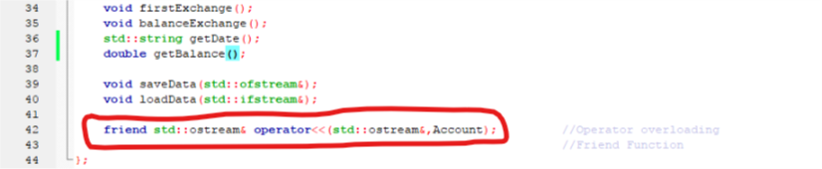

Slide 10
3. Operator Overloading
In C++, we can make operators to work for user defined classes. For example, we can overload an operator ‘+’ in a class like String so that we can concatenate two strings by just using +. Operator functions are same as normal functions. The only differences are, name of an operator function is always operator keyword followed by symbol of operator and operator functions are called when the corresponding operator is used.
Almost all operators can be overloaded except few. Following is the list of operators that cannot be overloaded.
. (dot)
::
?:
sizeof

Slide 11


Slide 12
4. Dynamic Memory Allocation
Dynamic memory management refers to manual memory management. This allows you to obtain more memory when required and release it when not necessary.
The new operator denotes a request for memory allocation on the Heap. If sufficient memory is available, new operator initializes the memory and returns the address of the newly allocated and initialized memory to the pointer variable.
The delete operator frees the allocated memory.

Slide 13
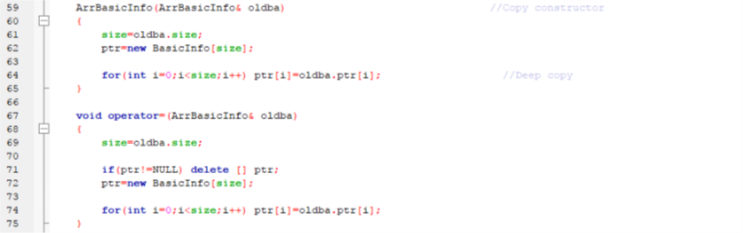

Slide 14
5. Constructor and Destructor
Constructors are special class functions which performs initialization of every object. The Compiler calls the Constructor whenever an object is created. Constructors can initialize values to object members after storage is allocated to the object. The name of constructor will be same as the name of the class, and constructors never have return type.
Destructor is a special class function which destroys the object as soon as the scope of object ends. The destructor is called automatically by the compiler when the object goes out of scope. The syntax for destructor is same as that for the constructor, the class name is used for the name of destructor, with a tilde ~ sign as prefix to it. Destructors will never have any arguments.

Slide 15
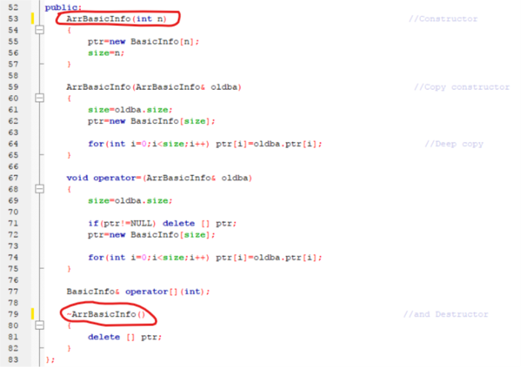

Slide 16
6. This Pointer
Every object in C++ has access to its own address through an important pointer called this pointer. The this pointer is an implicit parameter to all member functions. Therefore, inside a member function, this may be used to refer to the invoking object.
Friend functions do not have a this pointer, because friends are not members of a class. Only member functions have a this pointer.

Slide 17
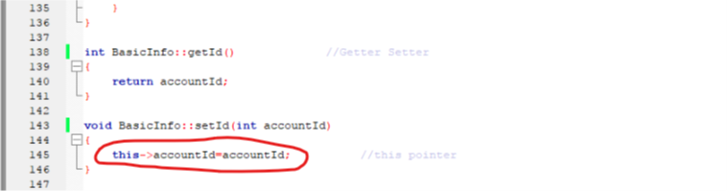

Slide 18
7. Formatted I/O
C++ provides various formatted console I/O functions for formatting the ouput. They are three types:
ios class functions and flags
Manipulators
User-defined output functions
The ios grants operations common to both input and output. The classes derived from ios are special I/O with high-level formatting operations.

Slide 19
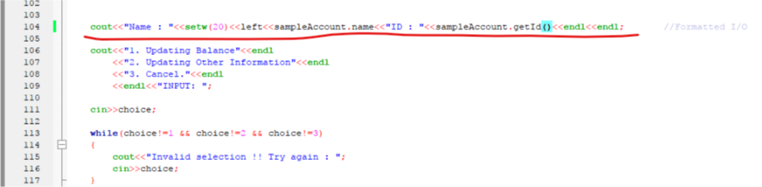
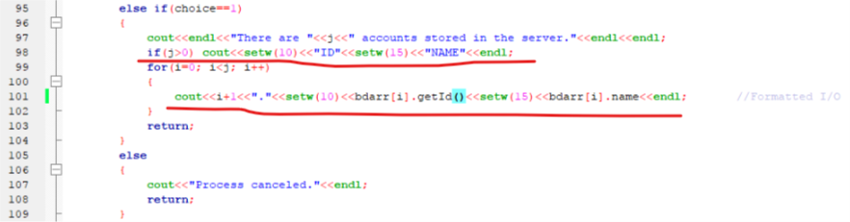

Slide 20
8. Copy Constructor
Copy Constructor is a type of constructor which is used to create a copy of an already existing object of a class type. It is usually of the form X (X&), where X is the class name. The compiler provides a default Copy Constructor to all the classes.
Shallow copy copies references to original objects. The compiler provides a default copy constructor. Default copy constructor provides a shallow copy. Shallow copy constructor is used when class is not dealing with any dynamically allocated memory.
Deep copy allocates separate memory for copied information. So the source and copy are different. Any changes made in one memory location will not affect copy in the other location. Allocating dynamic memory using pointers requires user defined copy constructor. Both objects will point to different memory locations.

Slide 21
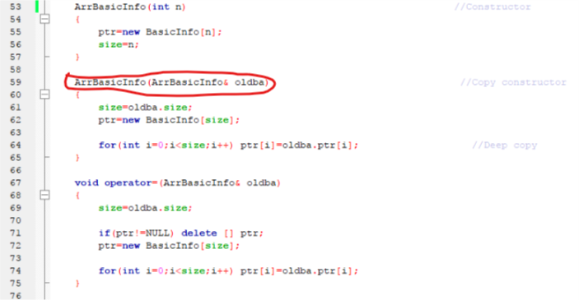

Slide 22
9. Namespace
Namespaces allow us to group named entities that otherwise would have global scope into narrower scopes, giving them namespace scope. This allows organizing the elements of programs into different logical scopes referred to by names.
Namespace is a feature added in C++ and not present in C.
A namespace is a declarative region that provides a scope to the identifiers (names of the types, function, variables etc ) inside it.
Multiple namespace blocks with the same name are allowed. All declarations within those blocks are declared in the named scope.

Slide 23
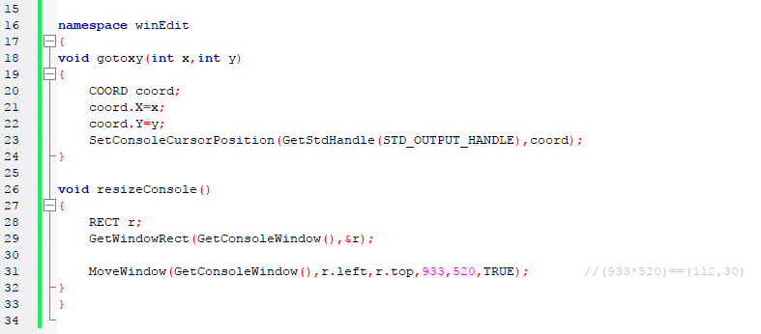

Slide 24
10. Getter Setter
Getters and Setters allow you to effectively protect our data. This is a technique used greatly when creating classes. For each variable, a get method will return its value and a set method will set the value.
The getters and setters are usually public and the variables are made private. Getters and setters are a common technique used in object orientated programming. It is good practice to use these getters and setters instead of changing the variables directly.

Slide 25
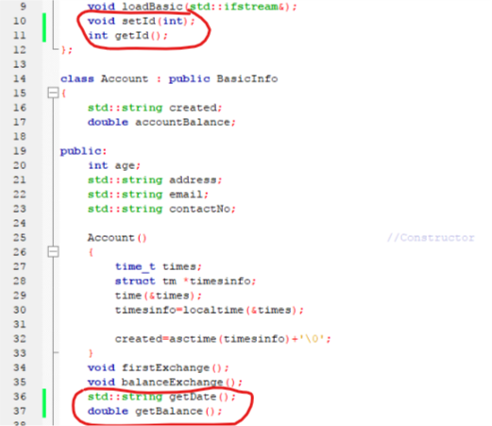

Slide 26
11. Inheritance
The capability of a class to derive properties and characteristics from another class is called Inheritance. Inheritance is one of the most important feature of Object Oriented Programming.
Super Class: The class whose properties are inherited by sub class is called Base Class or Super class.
Sub Class: The class that inherits properties from another class is called Sub class or Derived Class.

Slide 27
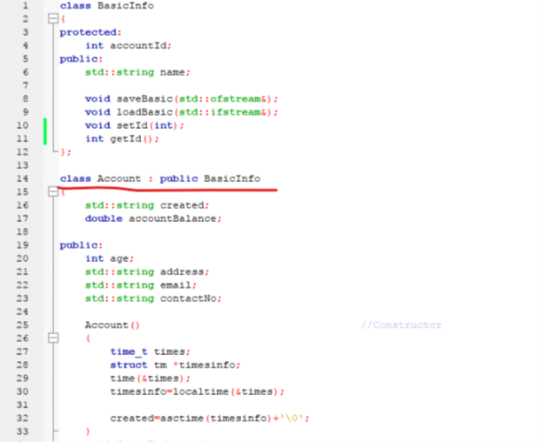

Slide 28
12. Polymorphism
Polymorphism is a feature of OOPs that allows the object to behave differently in different conditions. In C++ we have two types of polymorphism:
1) Compile time Polymorphism – This is also known as static (or early) binding. 2) Runtime Polymorphism – This is also known as dynamic (or late) binding.
Function overloading and Operator overloading are perfect example of Compile time polymorphism. Function overriding is an example of Runtime polymorphism. When child class declares a method, which is already present in the parent class then this is called function overriding, here child class overrides the parent class.

Slide 29
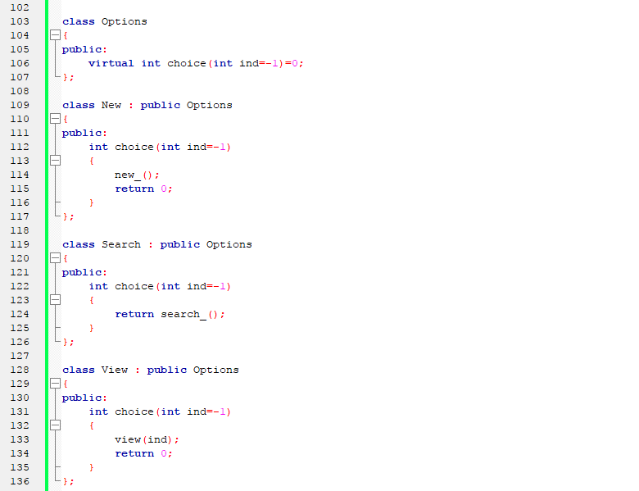

Slide 30
13. Template
A template is a blueprint or formula for creating a generic class or a function. The library containers like iterators and algorithms are examples of generic programming and have been developed using template concept.
Templates are often used in larger codebase for the purpose of code reusability and flexibility of the programs.The concept of templates can be used in two different ways:
Function Templates
Class Templates

Slide 31
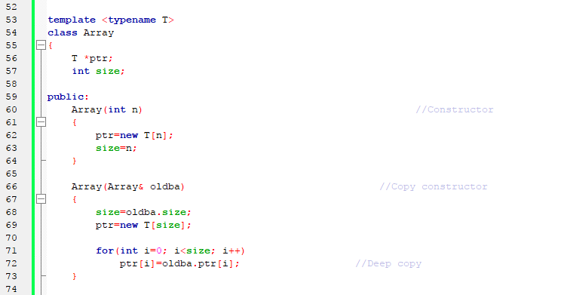

Slide 32
14. Functor
A functor is a construct allowing an object to be invoked or called as if it were an ordinary functions, Functors are called using the same old function call syntax. To create a functor, we create a object that overloads the operator(). usually with the same syntax (a function parameter that can also be a function).

Slide 33
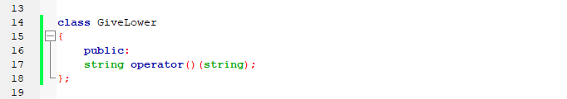
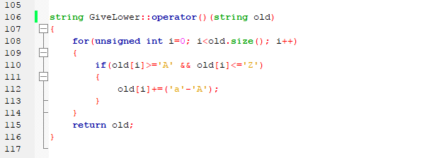

Slide 34
THANK YOU EVERYBODY

